Slide 1
Beauty and best
Tong Wu
INF 551

Slide 2
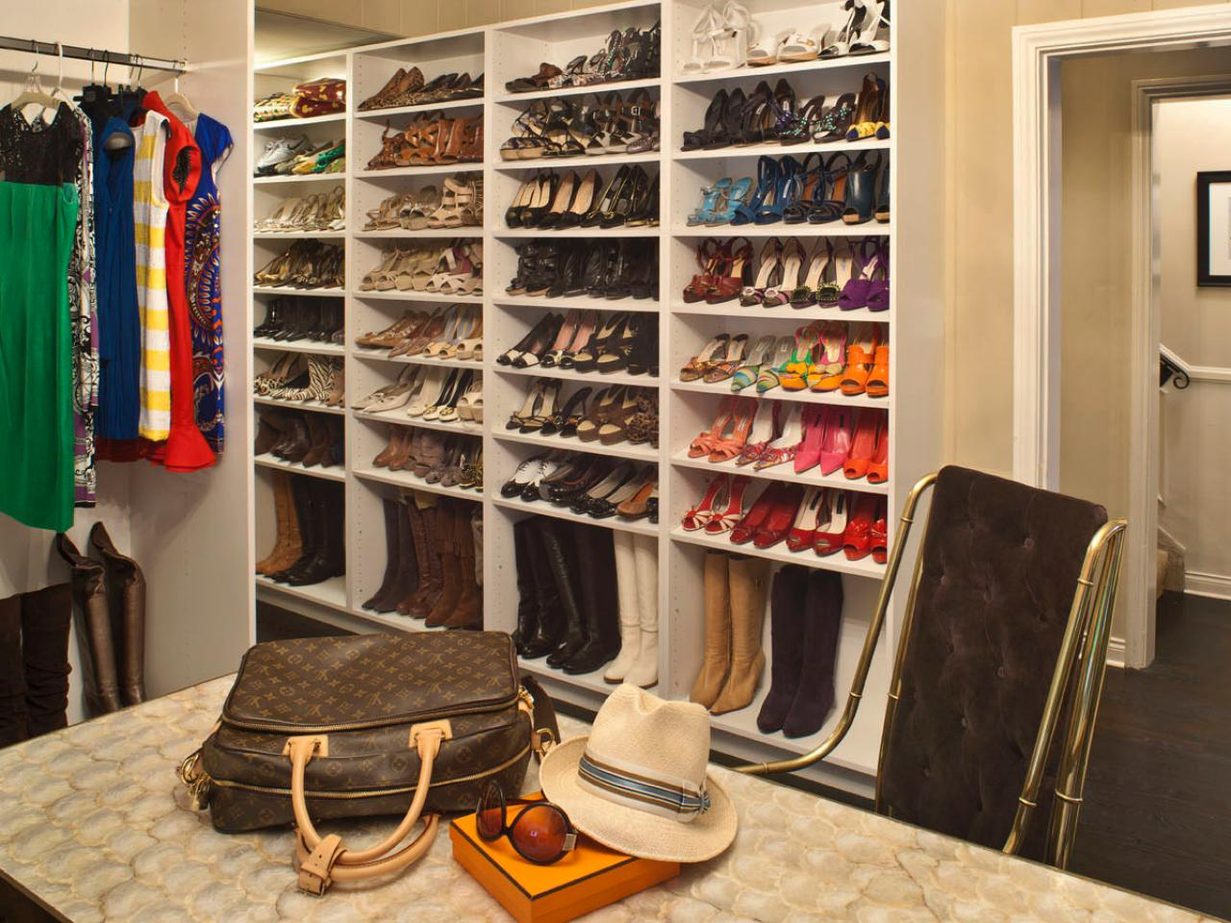
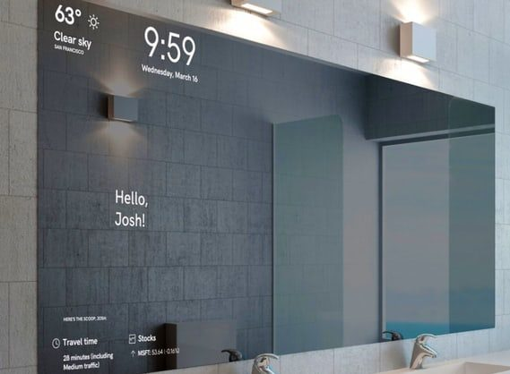
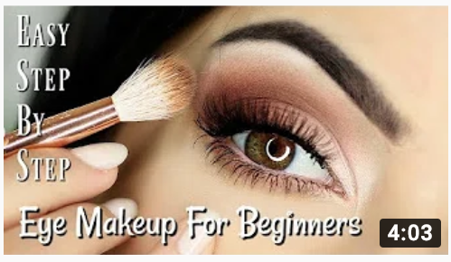

Slide 3
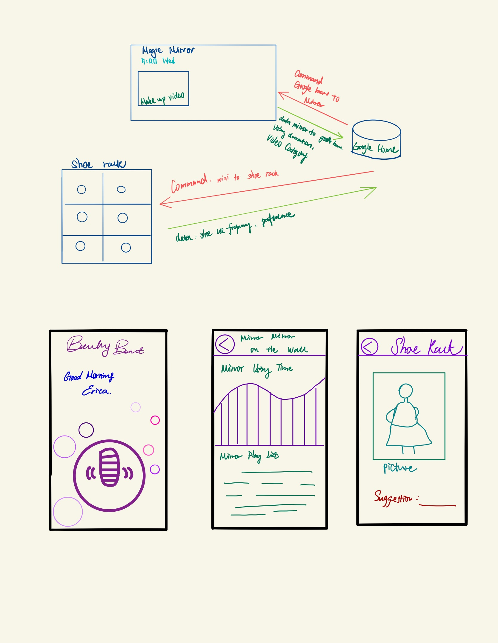
What & Why
Input: Voice input, image
Data: words, shapes
Output: usage data,
Personal preferences,
Recommendation play
List

Slide 4
Interface

Slide 5
time line & work
Jan -- Feb design, research
Feb – March data gather, data process
March – April App design
Plan A: X-code
Plan B: Python

